Slide 1
CS3441 Assignment Report

Slide 2
Objective
To design a fully functional two bit binary adder using basic logic gates which will produce a three bit output.

Slide 3
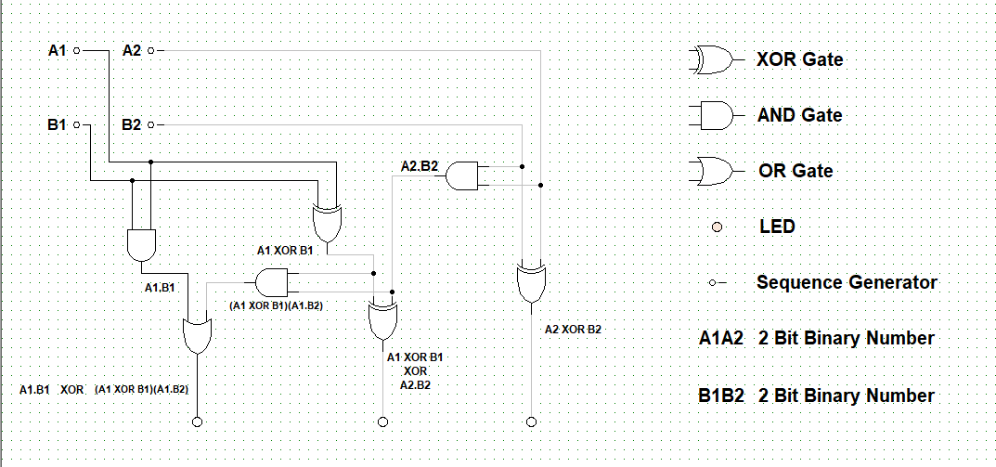
Schematic Diagram

Slide 4
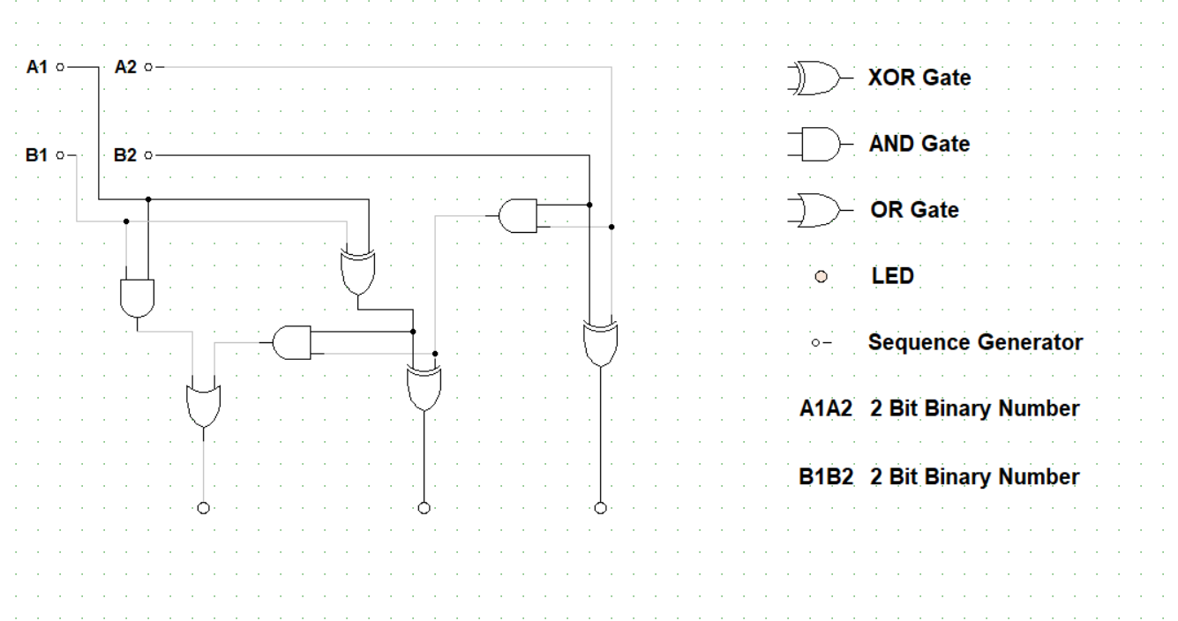
Simulation Process
In this case the inputs for A1A2 which is a two bit binary number are 00 and the inputs for B1B2 which is also a two bit binary number are 00 hence the adder’s output will also be 000.

Slide 5
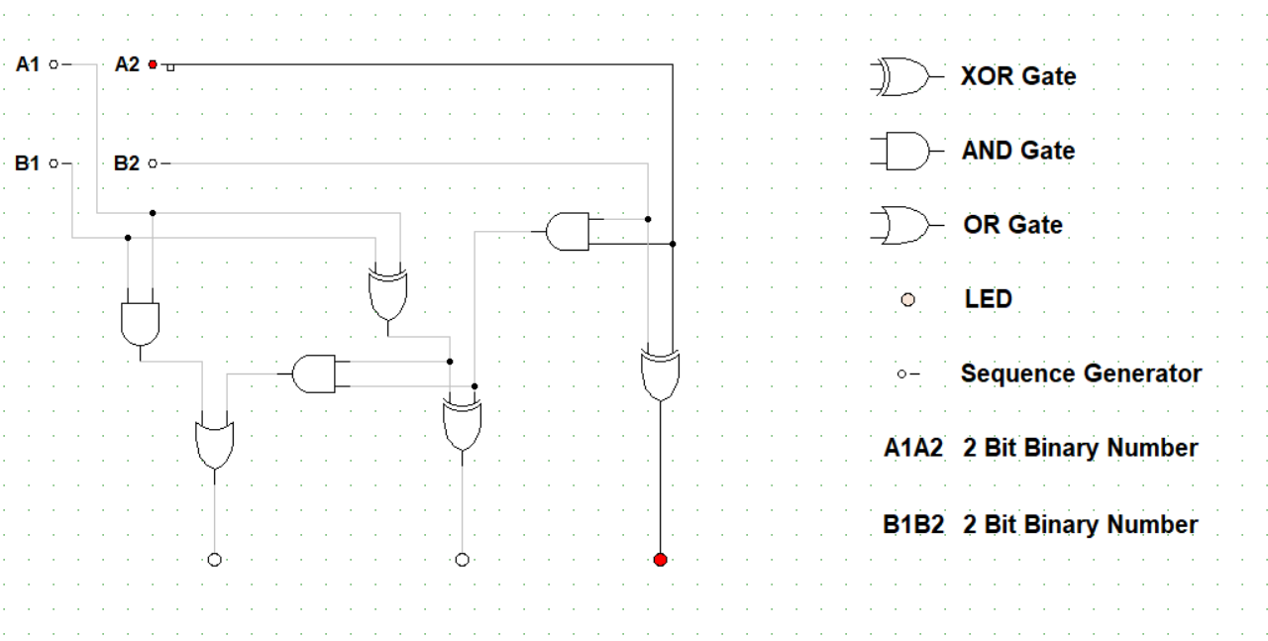
Simulation Process
In this case the inputs for A1A2 are 01 and the inputs for B1B2 are 00 hence the adder’s output will be 001 demonstrated by the picture on the right.

Slide 6
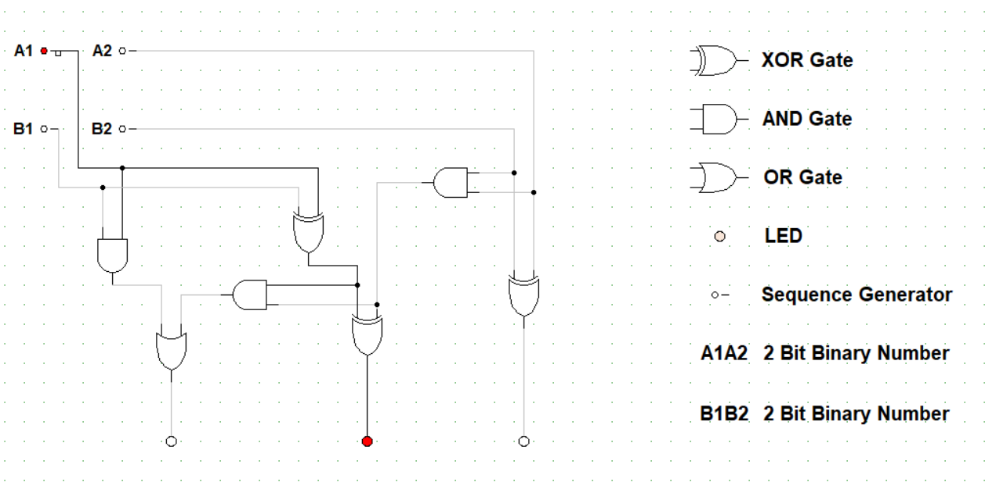
Simulation Process
In this case the inputs for A1A2 are 10 and the inputs for B1B2 are 00 hence the adder’s output will be 010 demonstrated by the picture on the right.

Slide 7
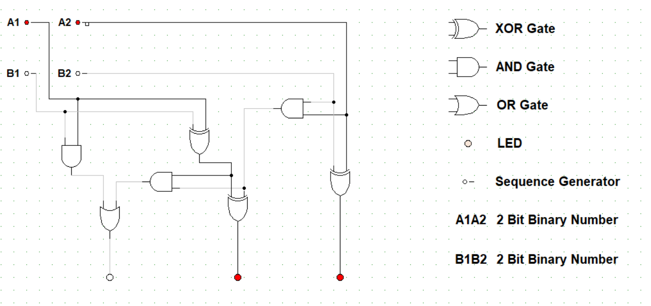
Simulation Process
In this case the inputs for A1A2 are 11 and the inputs for B1B2 are 00 hence the adder’s output will be 011 demonstrated by the picture on the right.

Slide 8
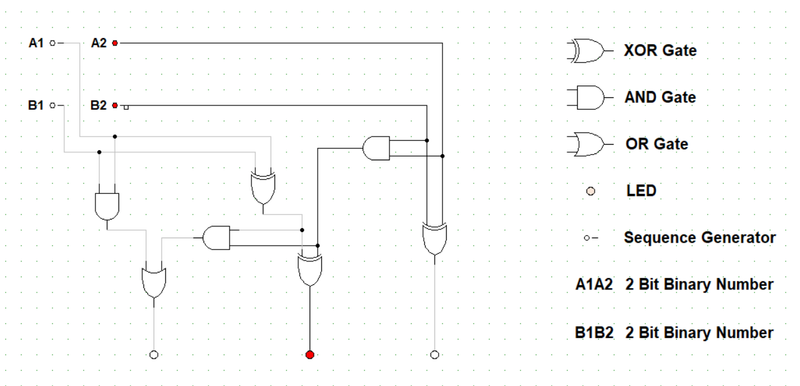
Simulation Process
In this case the inputs for A1A2 are 01 and the inputs for B1B2 are 01 but the addition to the least significant bits generates a carry output hence adder’s output will be 010 demonstrated by the picture on the right.

Slide 9
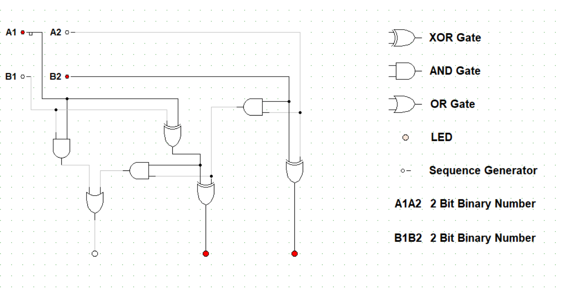
Simulation Process
In this case the inputs for A1A2 are 10 and the inputs for B1B2 are 01 hence adder’s output will be 011 demonstrated by the picture on the right.

Slide 10
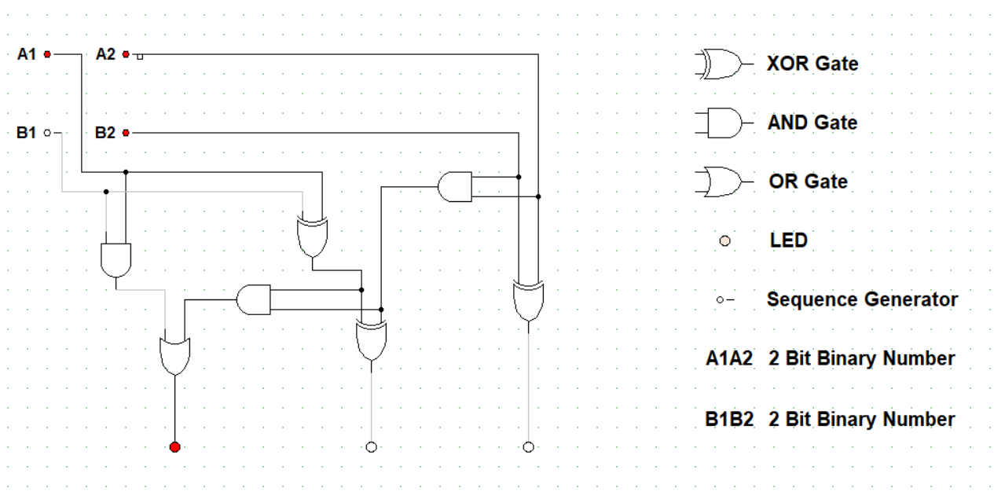
Simulation Process
In this case the inputs for A1A2 are 11 and the inputs for B1B2 are 01 but the addition to the least significant bits generates a carry output and the output is then added to the most significant bits also generating a carry output hence adder’s output will be 100 as demonstrated by the picture on the right.

Slide 11
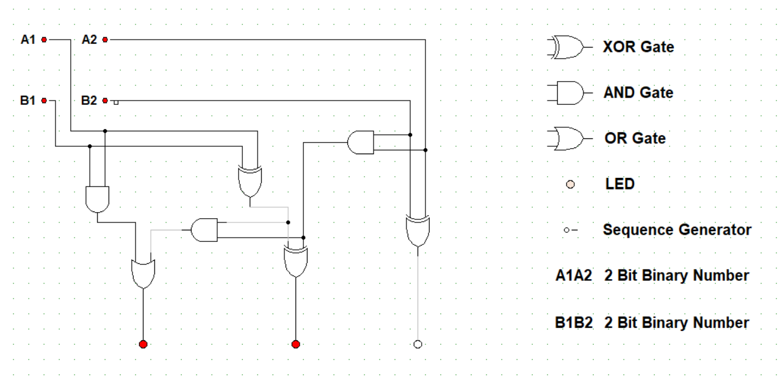
Simulation Process
In this case the inputs for A1A2 are 11 and the inputs for B1B2 are 11 but the addition to the least significant bits generates a carry output and leaves a zero behind and the addition to the most significant bits together with the carry output generates another carry output and leaves a one behind hence adder’s output will be 110 as demonstrated by the picture on the right

Slide 12
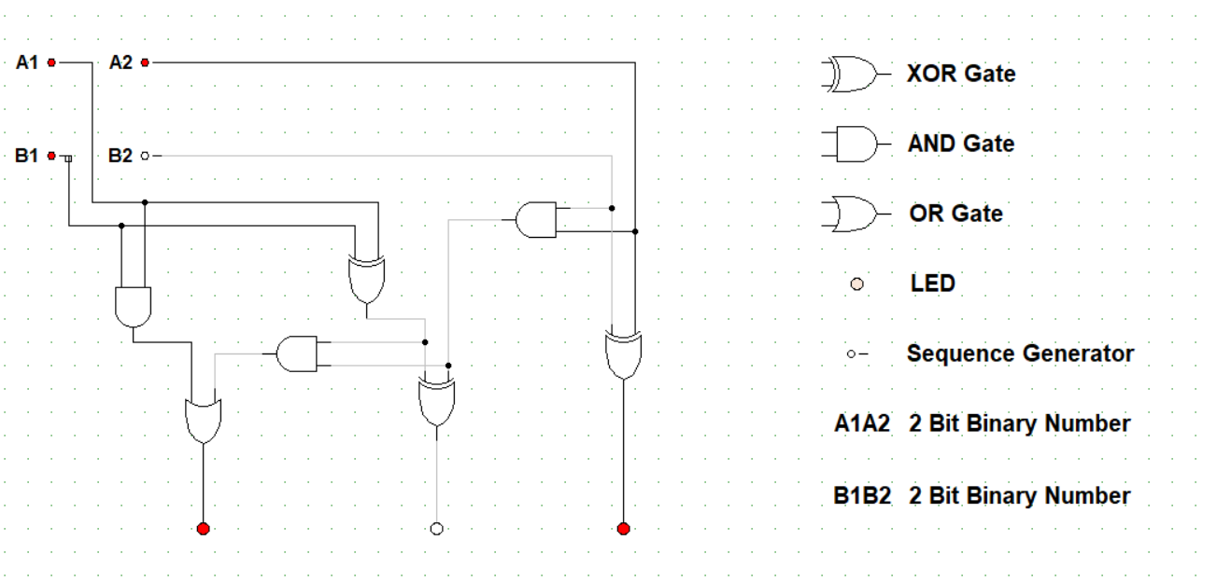
Simulation Process
In this case the inputs for A1A2 are 11 and the inputs for B1B2 are 10 but the addition to the most significant bits generates a carry output and leaves a zero behind hence adder’s output will be 101 as demonstrated by the picture on the right.

Slide 13
Testing Strategy
The group facilitated the use of trial and error method to test whether the full adder is fully functional.
Trial and error method- a fundamental method of problem-solving characterized by repeated, varied attempts which are continued until success, or until the practicer stops trying.
Different two bit binary numbers(Test cases) were input in different trials and the output was observed and confirmed to be accurate for all trials hence the conclusion was that the full adder is efficient and functions correctly.
During the testing some of the two bit binary numbers were not computed correctly due to the carry generated by the least significant bits not being considered by the full adder so the group referred back to the truth table for the adder and configured the gates such that the adder functioned correctly for every set of two bit numbers.

Slide 14
Conclusion
The conclusion was that two half adders can be used to built a fully functional full adder.

